Slide 1
Professional Workshop
Delta Kappa Delta

Slide 2
Agenda
Professionalism
Resumes
Cover Letter

Slide 3
Professionalism

Slide 4
Professionalism - Definition
Professionalism: The conduct or qualities that characterize or mark a profession or professional person.
Encompasses an individual’s behavior, appearance, and workplace ethics
Focus on the workplace before personal problems
Able to focus on work and avoid unnecessary distractions
Often perceived as more competent and valuable

Slide 5
Importance of Professionalism
Professionalism is important because it is necessary in many stages of our lives.
Classrooms
On campus
Organizations
Conferences
Interviews
Work Environments

Slide 6
Interview Day
Dress to Impress
Confidence
Responsibility
Dependability
Knowledgeable
Attentiveness
Honesty
Cooperation
Respect
Ambition

Slide 7
Dress to Impress
Please Do
Be confident and comfortable
Iron wrinkles and remove lint
Brush your hair and teeth
Look natural and clean
Upkeep with nails and toes
Wear flats or short heels
Please Don’t
Dress TOO comfortable
Wear tight or ill-fitted clothes
Show cleavage or bare skin
Use excessive perfume
Wear heavy makeup
Wear high heels and sandals

Slide 8
Inappropriate Dress
T-shirts
Sneakers
Flip flops
Wrinkled and/or unkempt shirt
Active attire
Jeans
Leggings
Short skirts

Slide 9
Professional Dress
Traditional Business
Tip: Always includes a jacket
Pantsuits, skirts, slacks, and blouses
Business Casual
Tip: Collared blouses, shirts, or jackets
Skirts, slacks, sweaters sets, and blouses with sleeves
Formal Business
Tip: One step down from tuxedos
Skirted suits, hosiery, closed-toe shoes, closed heel pumps

Slide 10
Professional Characteristics
27% Interpersonal Skills
25% Work Ethic
15% Communication Skills
15% Appearance
13% Time Management
5% Knowledge

Slide 11
Representation
Representing an Institution or Organization
Large responsibility because you will be the “face” and first impression that makes or breaks an individual’s perception of the college experience
Qualities you need to bring forward as a representative include:
Inclusiveness
Sociability
Support
Respect
Approachable
Awareness of the community

Slide 12
Proper Etiquette
Communication via Email
Follow up emails after interviews
Create meaningful and relevant subject
Always start with Dear Mr./Mrs.
Avoid first name bases as a form of respect
Use appropriate spelling and punctuation
Be clear, concise, and direct
Remain formal, but friendly
Thank them for their time
Follow up if they have questions
Have a great day
It was a pleasure to me you
Professional signature with contact information

Slide 13
Proper Etiquette
Signature for Associates
Best,
Priyanka Patel
Xi Class Associate, Fall 2014
Delta Kappa Delta Sorority, Inc.

Slide 14
Proper Etiquette
Signature for Sxsters
Best,
Priyanka Patel
Recruitment/Association Chair
Epsilon Chapter
Delta Kappa Delta Sorority, Inc.
“Sxsterhood Built Through Service”

Slide 15
Proper Etiquette
Communication via Phone
Be sure to answer the phone in a timely manner
Greet when answering: “This is [name]”
Smile when you talk on the phone
Speak clearly, slowly, and at a medium volume
Ask for the caller’s name and write down important information
Remain formal, but friendly
Thank them for their time
Follow up if they have questions
Have a great day
It was a pleasure to me you
Avoid speaker, gum, eating, bluetooth, and driving

Slide 16
Resumes

Slide 17
Resume - Purpose
A resume should represent the truth about you in the best possible light
The main purpose of your resume is to get you in the door for a job interview
On average, employers spend less than 60 seconds reading a resume, so you have to make a good impression quickly
Employers look for mistakes in resumes as frequently as they look for great achievements
Your resume will be important throughout you entire career, though the format will change as you gain more experience

Slide 18
Resume - Heading
Name
Permanent address
Current address
Telephone number
Email address
LinkedIn

Slide 19
Resume - Education
Degree and expected date of graduation
Concentration
GPA
Thesis title (if any)
Relevant coursework
Awards
Academic societies

Slide 20
Resume - Work Experience
Job title
Name of employer/activity
Dates of position
Use action verbs to describe skills utilized
Emphasize impact/results of your roles

Slide 21
Resume - Leadership Experience
Same format as work experience
Emphasize leadership capabilities in positions held

Slide 22
Resume - Personal
Fluency in languages
Interests
Computer skills
Certificates
Publications

Slide 23
Example - Education
Use specific detail and numbers to describe your coursework, grades, and academic achievements.
Education
Harvard University August 2010 to May 2014
Bachelor of Arts
Majors: Economics
Honors: Dean’s List Fall 2011, Dean’s List Spring 2013, Undergraduate Award in Economics
Awards: $10,000 Glenn Rhodes Wilson Scholarship in Economics 2010 - 2014

Slide 24
Example - Jobs and Education
Use action verbs to precisely describe your actions and numbers to describe results that you achieved.
Professional Experience
McBain Consulting Boston, MA
Associate Consultant September 2014 - Present
Led recruiting campaign that increased applicants by 20% to all-time high of 3,000
Conducted analysis that led to a 40% cost reduction for major McBain Consulting client

Slide 25
Example - Interests
Employers want interesting and skilled colleagues
Interests: Reality TV, collecting stamps, reading mystery novels
Skills: Juggling hot knives, cooking, playing pool, skiing
Languages: French (fluent) and Chinese (basic)
Travel: France, Portugal, Suriname

Slide 26
Resume Formats
Try to limit your resume to one page (except academic resumes)
List your activities in reverse chronological order (most recent ones first) within each subsection
However, place more important activities before lesser ones (regardless of chronological order)
Use bullet-points for emphasis of important achievements and for spacing
Consistently use bolding and italics for titles and headings
Use a structure that is appropriate for the type of job to which you are applying
“Research Experience” for a science job
“Volunteer Experience” for a non-profit job

Slide 27
Resume Preparation
Review sample resumes
Inventory your skills, accomplishments, and experiences
Prepare a draft
Have your resume critiqued
Modify resume as necessary for different types of jobs and additional experiences

Slide 28
Resume - Dos and Don’ts
Do
Be clear and concise
Use action verbs
Quantify your achievements where appropriate
Focus on the results of your actions
Proofread
Don’t
Use extremely small fonts or margins
Lie
Use strange fonts or colors
Print on colored or perfumed paper
Make spelling mistakes

Slide 29
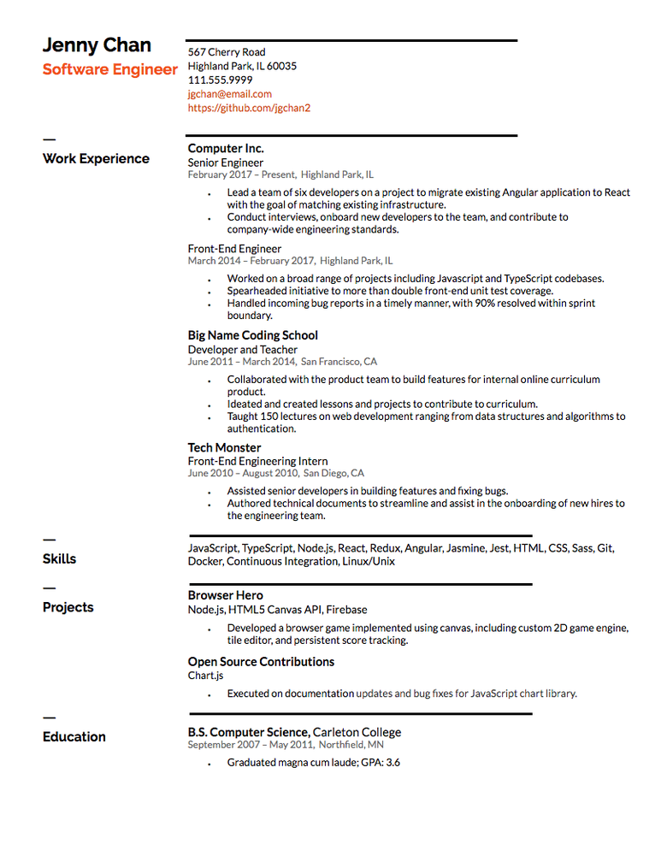
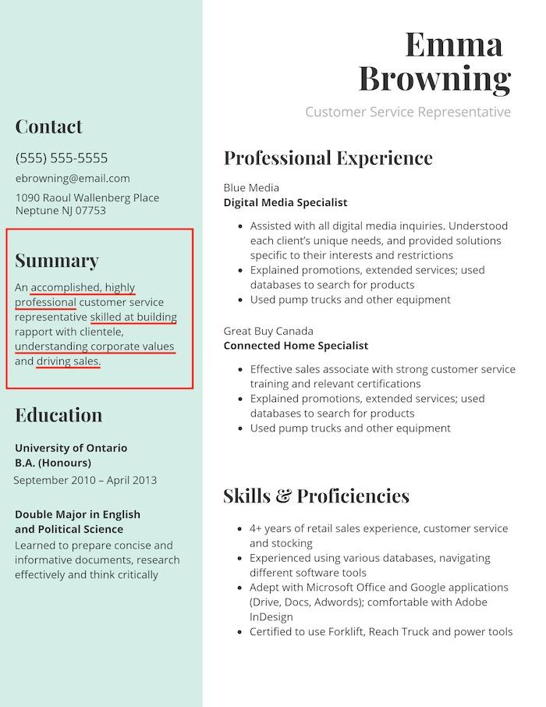
Resume - Good Resume

Slide 30
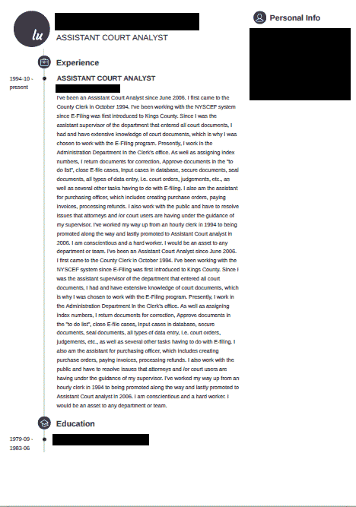
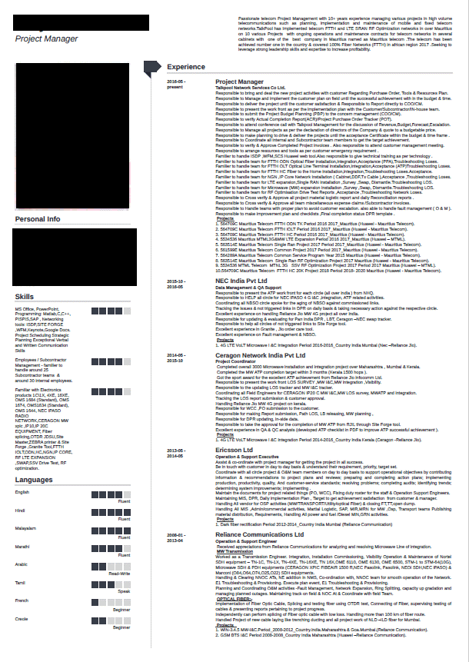
Resume - Bad Resume

Slide 31
Cover Letters

Slide 32
Cover Letter - Purpose
A terrific resume might never get read if the cover letter is not up to par
A good cover letter
Offers you the opportunity to personalize your application packet
Enables you to state clearly why you are interested in the company and how you match their needs
Allows you to direct attention to specific skills and go into more detail about your key attributes
Opens the door for future communication

Slide 33
Cover Letter - Format
State the purpose of your letter at the beginning
Explicitly state the position for which you are applying
Briefly describe your interest in the company and position
Why do you want the job?
What about it interests you?
What skills or knowledge could it teach you?
Pick a few strong selling points from your resume and elaborate on them
Demonstrate why you are a good candidate through your experiences and actions in a given activity, situation, or class
Be detailed
Thank the reader for his/her consideration and encourage a response

Slide 34
Cover Letter - Narrative
Introduction
How did you become interested in this general area or type of work?
Plot
What steps did you take to pursue this interest?
How did key experiences shape this trajectory?
Did you realize new interests through an experience?
Did you learn key skills through an experience?
Describe how you gained these interests/skills

Slide 35
Cover Letter - Narrative
Conclusion
Why does your trajectory lead you to seek an opportunity of this sort?
Tie your experiences/interests/skills to the position
How would getting this position help you pursue the interests you have described?
Why would the organization be a good fit for you?
What special characteristics make it a good match?

Slide 36
Cover Letter - Dos and Don’ts
Do
Demonstrate you’ve researched the employer and the position
Highlight one or two items from your resume
Describe items in more depth than your resume
Address potential relevant concerns from your resume
Proofread
Don’t
Refer to the wrong industry or different employer
List everything that is included in your resume
Repeat exactly what is in your resume
Draw attention to minor flaws
Use more than one page
Make small spelling mistakes

Slide 37
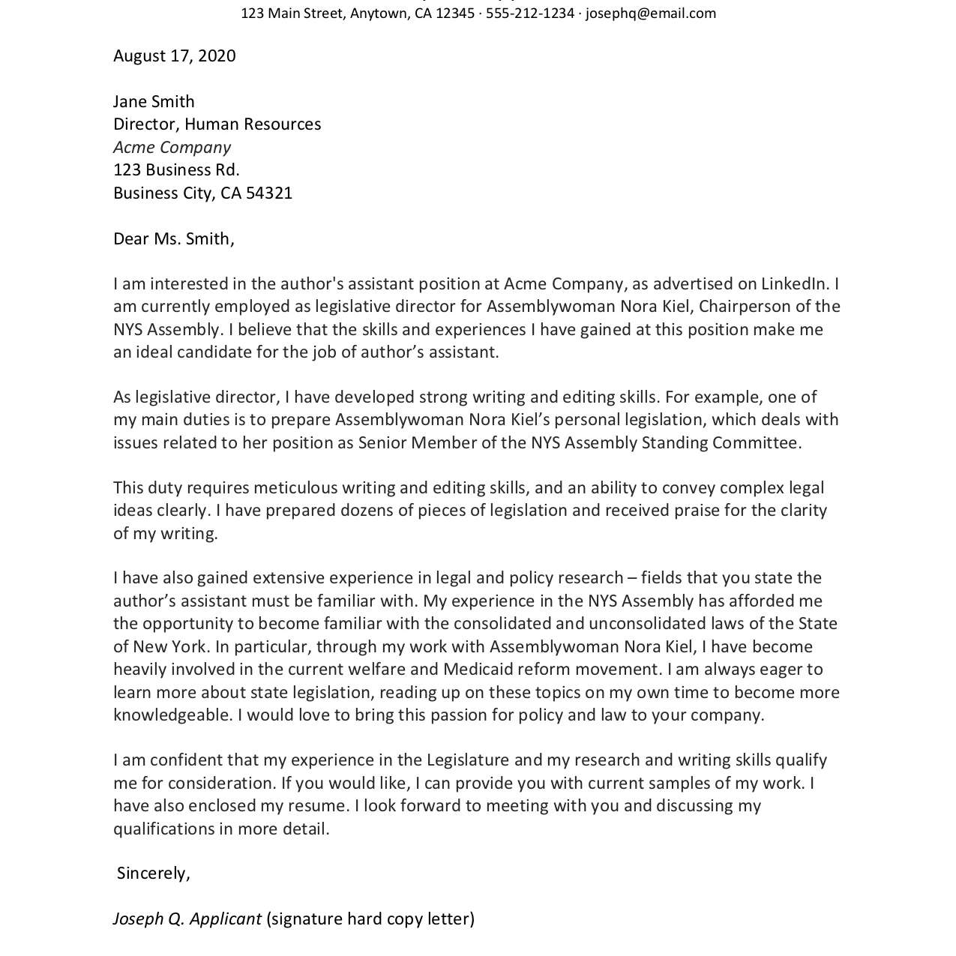
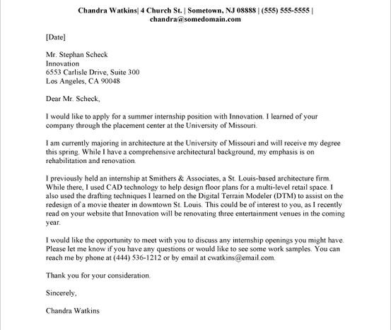
Cover Letter - Good

Slide 38
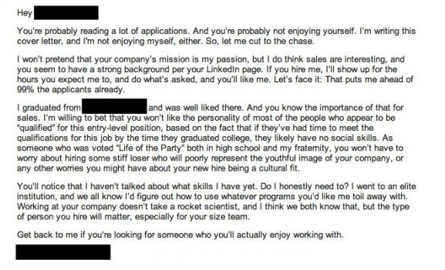
Cover Letter - Bad

Slide 39
Thank You!

