Slide 1
Peer Mediator Training
Delta Kappa Delta

Slide 2
Agenda
Who Do Conflicts Occur?
How to Deal with Conflict
Formal Mediation guidelines
Escalation vs De-escalation Factors
How to Run a Chapter Mediation
Mental Health
Building Sxsterhood

Slide 3
“You cannot shake hands with a clenched fist”
- Indira Gandhi
Notes:
First off, congratulations on becoming Peer Mediator for the upcoming semester! It may not seem like it but the mediator is a very important position, and is a pillar of strength for each and every charter.
Semesterly/monthly meetings to review issues, etc.

Slide 4
Why Do Conflicts Occur?
Different needs, goals, drives, wishes
Different values, beliefs, customs, norms
Limited resources
Miscommunication, misunderstanding, poor communication
Lack of planning
Frustration, stress, feeling of burnout
Differential power/status relationships
Different interpretations of information
Violation of personal boundaries
Old wounds never being addressed or healed
Notes:
Miscommunication, talking about rather than to a person, holding grudges and differences in opinion are the most common sources of conflict. Understanding the nature of an issue taking place between sisters/within your charter is very important to being able to execute mediations properly.

Slide 5
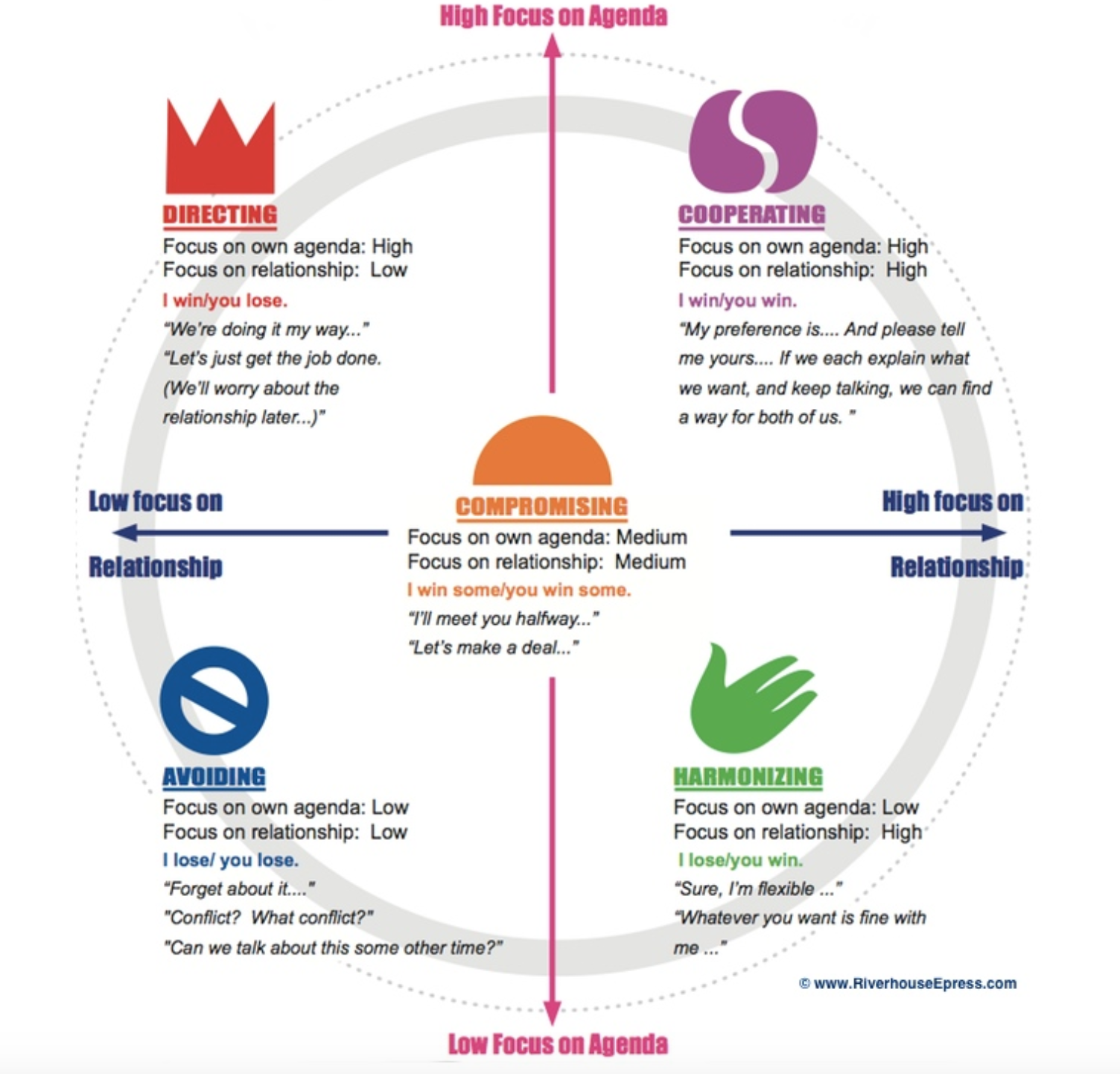
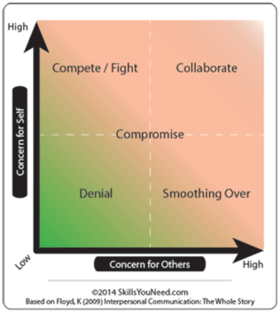
How Individuals React to Conflict
Notes:
Compete/Fight- it’s their way or the highway mentality
Smoothing Over- They let others take advantage of them
Denial- in difficult situations they avoid conflict and withdraw
Collaborate- this person will focus on the situation that took place rather than attacking the other person

Slide 6
Ways That Mediators Deal with Conflict
Hosting formal conflict mediations
1 on 1
With entire charter
Helping each sister understand their own reaction to conflict as well as acknowledging how the other sisters reacts
Creating action steps to prevent/resolve issue
Privately discussing steps that can be taken to individual sisters rather than the entire charter
End of semester mediations
Notes:
When a sister understands and acknowledges her own reaction to conflict, you can suggest action steps and ideas to help deal with the conflict.
Stepping away- have them take a break to get their emotions under control, accept their feelings and manage their physical response. Taking deep breaths, meditation, or even a moment of silence could be beneficial in helping the sister to remain calm
Listen to the other person- it is hard for us to actively listen when we feel we may have been wronged, but encourage active listening. One way to see if sisters are actively listening is to have them talk one at a time. After the first person is done speaking have the listener repeat back what she is hearing, this will help eliminate misinterpretations of information.
Stay focused on the present- this is very important!! Have them focus on today and moving forward
Being there for sisters to vent to. As mediator, you are there to help sisters through any conflicts that arise. Sometimes sisters just need someone to vent to, and then they are able to move forward from an issue without dwelling on it. Encourage this at your charters and ensure that all venting is kept confidential. Serious incidents need to be reported to national board. As peer mediator you are seen as a symbol of trust at your charter, remember to uphold this confidentiality.

Slide 7
Other Mediator Responsibilities
Sisterhood activities
Anonymous complaint form
Maintaining confidentiality amongst sisters
Awareness of others
Advocating for positivity
Mental health wellness
Stress relief

Slide 8
Formal Mediation Guidelines
Step 1 - Set the stage, set up ground rules
Step 2 - Describe the conflict
Step 3 - Identify the issue
Step 4 - Generate options
Step 5 - Test options
Step 6 - Agreement and closing
Notes:
Establish the purpose of the meeting. Affirm/reaffirm the willingness of both party's desire to be there and their desire to seek a solution.
Establish mediator/facilitator role. - Mediator/facilitator not going to decide who is right or settle the conflict - Mediator/facilitator to help the parties speak openly to each other and hear each other's point of view so that some better basis for resolving the differences can be established. The point of mediations is not to determine who is right and who is wrong in any given situation. By establishing this idea upfront it will allow sisters to communicate more openly and freely. Sisters are entitled to their own feelings and opinions, however they should acknowledge each other and determine how to best move forward.
Establish time limits for the discussion (may need to schedule another meeting).
Set ground rules. - establish ground rules about confidentiality - affirm/reaffirm willingness to seek resolution - other ground rules relevant to the situation
Define the problem.
Identify the positions: Have each person explain in 5 minutes how they see the situation, without interruptions from the other. Mediator might summarize what they have just heard or have each party summarize what they heard the other say. Ask each person what it is that the other person doesn't understand yet that he/she wants them to hear.
Identify the interests (the underlying needs, expectations, apprehensions, perceptions, goals, etc.). Have each person talk about their expectations, needs, perceptions and apprehensions for 5 minutes without interruptions from the other. Mediator might summarize what they have just heard or have each party summarize what they heard the other say. Ask each person what it is that the other person doesn't understand yet that he/she wants them to hear. - Identify/search for common themes/points of agreement - Identify differences/points of real disagreement.
Make sure parties have thought about their BATNA (their best alternative to a negotiated agreement, i.e., what they will do if an agreement isn't reached).
Generate alternative options (via brainstorming) that might/could address each party's interests.
Evaluate options and the consequences of each option: Have people assess their "currently perceived choices" and their "target future choice".
Search for a solution: seeking alternative(s) which address interests of both parties.
Identify a plan of action/agreement and ensuring commitment to it.
Evaluate/check-in at set time in the future.
All initial mediations should be with the peer mediator and the involved parties only. If the peer mediator feels that the issue is too large or has not subsided, VPIA can then get involved.

Slide 9
When to Contact VP of Internal Affairs
Attempt a mediation following these guidelines with the involved parties only
Set up a window of time to allow the issues to resolve after the mediation
If the conflict is still present/involves the entire charter contact Charter Advisor and VPNMI
Schedule mediation with charter, charter advisor, alumni, and VPIA

Slide 10
Escalation vs. De-Escalation Factors
Escalation Factors
Aggressive body language
Raised/Aggressive tone of voice
Accusatory statements
Blaming statements
Vague threats
Personal insults
Grudges
De-Escalation Factors
Neutral body language
Calm tone of voice
Using “I” statements
Acknowledging/Validating feelings
Acknowledging perspectives
Scheduling a specific time to talk
Self Awareness
Honesty

Slide 11
How to Run a Chapter Mediation
Send out an anonymous google form a week in advance. Review the responses prior to the session
What do you think is going well this semester
What do you think could be improved
Are there any issues you would like to address?
Questions can vary
Set the stage
Have everyone put phones away.
Warm up with highs and lows,
How has the semester/week has been going?
This can include general sisterhood questions as well
Do you trust the sisters around you?
Is there something you would like to change about --topic---?
How can we improve?
What do you wish to see from others?

Slide 12
How to Run a Chapter Mediation
Discuss
Go through the responses one by one and have individuals discuss their feelings.
Determine what can be improved or any actions steps to take moving forward in order to better the situation
Open Forum
Ask if there is anything else that someone would like to discuss/address
Opportunity to speak one’s peace.
Conclude
End with celebrations
something that you are thankful for
what you’re looking forward to that week
an inspirational quote
Something positive

Slide 13
Mental Health
Mediation during times of conflict and stress
1:1 check ins
Inspirational quotes

Slide 14
Building Sxsterhood
Even when there are no immediate conflicts, mediators should be actively working to strengthen sisterhood within the chapter
Highs and lows at the end of chapter meetings
Positive affirmations at the end of chapter meetings
Lunch buddies
Speed dating
Celebrations
Potlucks/friendsgiving
Birthday baskets
Fun icebreakers during sisterhood socials
Leadership building exercises
Reading the creed at the end of chapter meetings

Slide 15
Thank You!

